Slide 1
Dispatch Role
Crisis Intervention Teams
Cindy Boyle, South Hadley Police Department
Law Enforcement Coordinator
Western Mass CIT-TTAC

Slide 2
Memphis Model
The Sept. 24, 1987, shooting at the LeMoyne Gardens public housing project led to the creation of the Memphis Police Department's Crisis Intervention Team. The man was cutting and stabbing himself with a butcher knife, inflicting as many as 120 wounds on his body. The police came. Exactly what happened after that is disputed, but in the end, police had shot and killed a 27-year-old man named Joseph DeWayne Robinson.
The CIT pioneers envisioned a team of uniform patrol officers selected for specialized training in basic crisis intervention. The officers would be spread throughout the city on all shifts. These officers would perform the usual duties of uniform patrol officers but would be available for immediate dispatch to mental health crisis scenes. CIT officers would be able to de-escalating the crisis, decreasing the likelihood of violence and injury to patients, family members, neighbors and police officers.

Slide 3
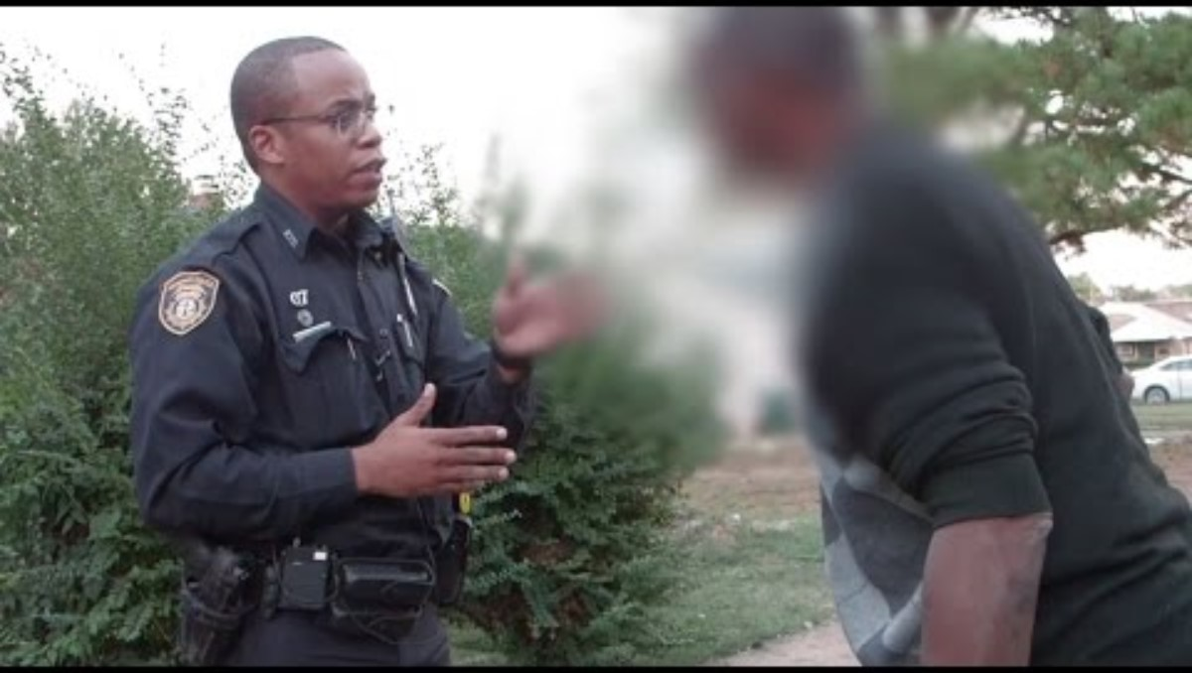

Slide 4

Department of Mental Health
Jail Diversion Program (JDP) Grants
Grant money that can supplement a training budget
Help create and sustain a Crisis Intervention Team
Help create and sustain a Co-Response Program
Both single and regional department grants are available
COMMBUYS

Slide 5
Crisis Intervention Teams
Community alliance of law enforcement, addiction counselors, mental health professionals and other advocates.
CIT reduce arrests of people with mental health conditions, while simultaneously increasing the likelihood that individuals will receive mental health services.
Research shows that CIT is associated with improved officer attitude and knowledge about mental health conditions.

Slide 6
Crisis Intervention Teams
The primary goals of the CIT program are:
  Increase officer and consumer safety.
  Redirect individuals in crisis away from the criminal justice system and toward treatment and recovery.
  Reduce stigma for individuals in crisis and serve people with mental health conditions and/or substance use disorder with respect.

Slide 7
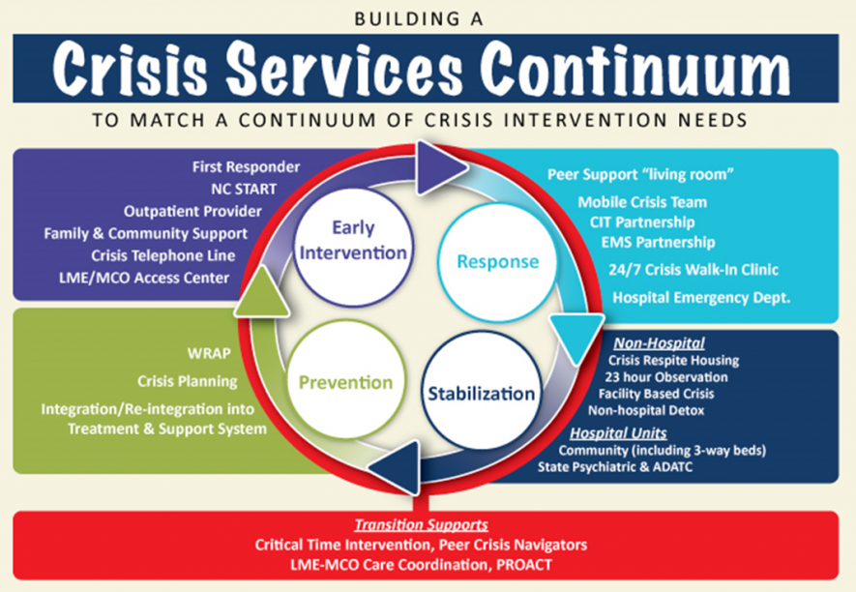

Slide 8
Building Mental Health into Emergency Responses:
There have been mental health professionals embedded in police departments across the country for many years.
Ashley Abramson
American Psychological Association
July 1, 2021 Vol. 52 No. 5

Slide 9
National Survey of 2400 Senior Law Enforcement Officers
84% said mental health calls have increased during their careers.
63% said the amount of time on scene has increased on these calls.
> 50% agree that the increased time is due to the inability to refer people to needed treatment.

Slide 10
This integrated response of CIT certified police officers and mental health clinicians is a more appropriate means of meeting the needs of individuals who are struggling with mental health or substance related issues.
This type of co-response program is founded on the understanding that by working together we can respond more effectively to the needs of our residence.

Slide 11
Goals of Co-Response
Increase connection to services
a.) Provide options of MH/SA Out-Patient Services, housing, food banks, Mass Health coverage.
Reduce the Pressure on the Criminal Justice System
a.) Diminish avoidable arrests.
b.) Reduce officers time on scene.
Reduce the Pressure of the Health Care System
a.) Decrease On-scene Section 12’s.
b.) Cross Trainings with officers/co-responders emphasizing strength.
Maintain Cost Effectiveness
a.) Assist people to remain in the community
b) Follow-up evaluations.
c.) Remain on scene while officers return to their duties.

Slide 12
Behavioral Health Roadmap
January 3, 2023
The Roadmap for Behavioral Health Reform helps people in Massachusetts get the mental health and substance use care they need, when and where they need it. Through a 24/7 Behavioral Health Help Line (BHHL) and statewide network of Community Behavioral Health Centers (CBHCs), the Roadmap connects people with supportive services right in their communities.
Together, the Roadmap programs form a “front door” to behavioral health, making it easier than ever before for individuals and families across Massachusetts to access critical mental health and substance use services.

Slide 13
BHHL
Behavioral Health Help Line
Call or text 833-773-2445 (BHHL)
Start a chat at masshelpline.com/chat.
Deaf or hard of hearing? If you use a TTY, contact MassRelay at 711. Otherwise, call through your video relay service at 833-773-2445.
Open 365 days a year, the call/text line and online chat service is completely free (no insurance needed) and is available in over 200 languages.

Slide 14
988
988 Lifeline Chat and Text is a service of the 988 Suicide & Crisis Lifeline (formerly known as the National Suicide Prevention Lifeline), connecting individuals with crisis counselors for emotional support and other services via web chat or texting 988.
Veterans Press 1

Slide 15

Know your why

Slide 16


Western Mass CIT-TTAC

